Slide 1
Can book anything
PRODUCT BASED

Slide 2
Team Members
21100030376-B.Manish
2110030395-N.Mani teja
2110030402-Pranay
2110030403-Sri Harsha

Slide 3
INTRODUCTION
Put simply, an online booking system is a software solution used for reservation management. Before such systems were available, in order to track bookings and manage inventory, travel agents had to work with a series of spreadsheets and enter the information manually.
Instead, an online booking system uses smart technology that eliminates the risks associated with manual input and human error. It simplifies the booking process for you and your customers by automatically updating processes such as payment scheduling, inventory management and tracking bookings.
It keeps customers on your website since they can see all of the available options and book the ones they need without switching between web pages or going to other websites.

Slide 4
OBJECTIVE AND PURPOSE OF THE PROJECT
The objective of can book anything is about to create a online booking system of the products and know the location of the product.
Online bookings in real time.
Various currencies and languages.
Voucher generation and management via the online booking system.
Payment via PayPal and online payments.
Intelligent calendar.
Online and telephone support for booking software.
Automated e-mails make management easier.

Slide 5
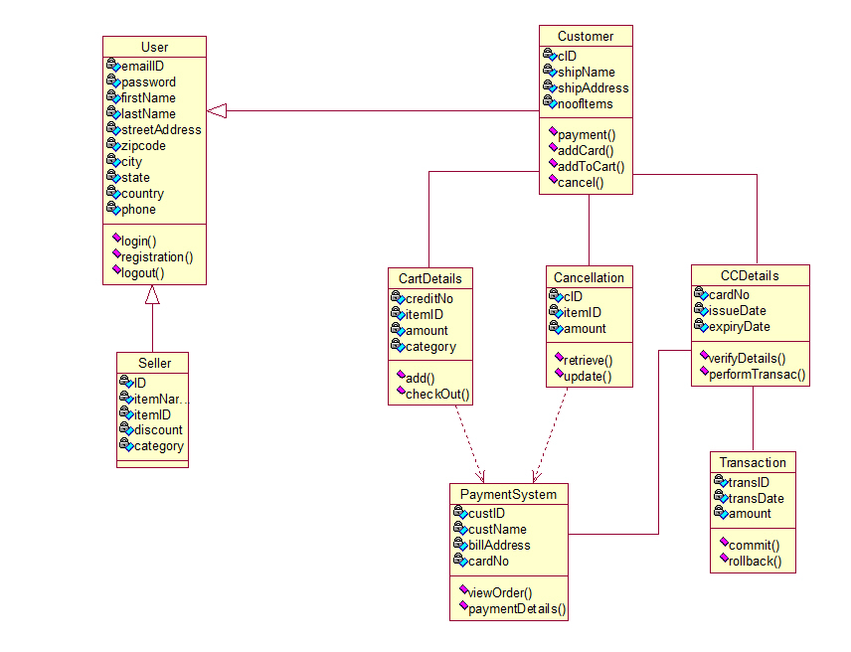
CLASS DIAGRAM

Slide 6
GITHUB SETUP
https://github.com/pranay2456/Video-Conference-Web-Application/tree/main/DBMS

Slide 7
CONCLUSION
This the process of the online booking and the product details and making the online products buy.
We can see the location of the product and shipping details and the return product.
Online products buying and other online booking is done here
The web based “can book anything” project is just another attempt to stimulate the basic concepts of online booking system. The system follows a simple process which allows the customer to check availability of products and tracking details.

